Slide 1

Can Machine Learning Predict Future Stock Price?
Natasha Crosby

Slide 2
The problem
Trading stocks can be time intensive due to the massive amount of research that can be done to decide whether or not a stock is worth trading.
Even with all of the research there are still factors present in the market that it difficult to be a successful trader.
2015 | 2016 | 2017 | 2018

Slide 3

The solution
Machine Learning makes it easier to decide if a stock is worth trading.
By training a ML algorithm to learn the patterns of historical stock data you can test it on current data to predict future results.

Slide 4
FNMA STOCK PRICE
January 2010 - January 2017
January 2010
Jan 2014
Jan 2017
Jan 2012
Jan 2016
FNMA = 1.18
FNMA = 3.24
FNMA = 3.96
Jan |  | Jan |  |  | Jan |  |  |  | Jan
FNMA = .22
FNMA = 1.70

Slide 5
How it works
Step 3
Step 2
Step 1
Plot the future prediction
Evaluate the trained model for accuracy
Use Simple Linear Analysis, Quadratic Discriminant Analysis (QDA), and K Nearest Neighbor (KNN) to predict Stock Movement

Slide 6

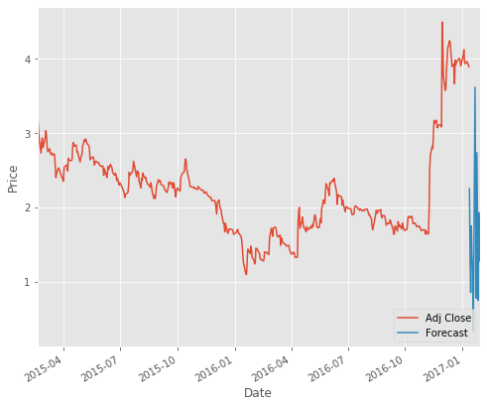

Slide 7

Thank You!

